Slide 1
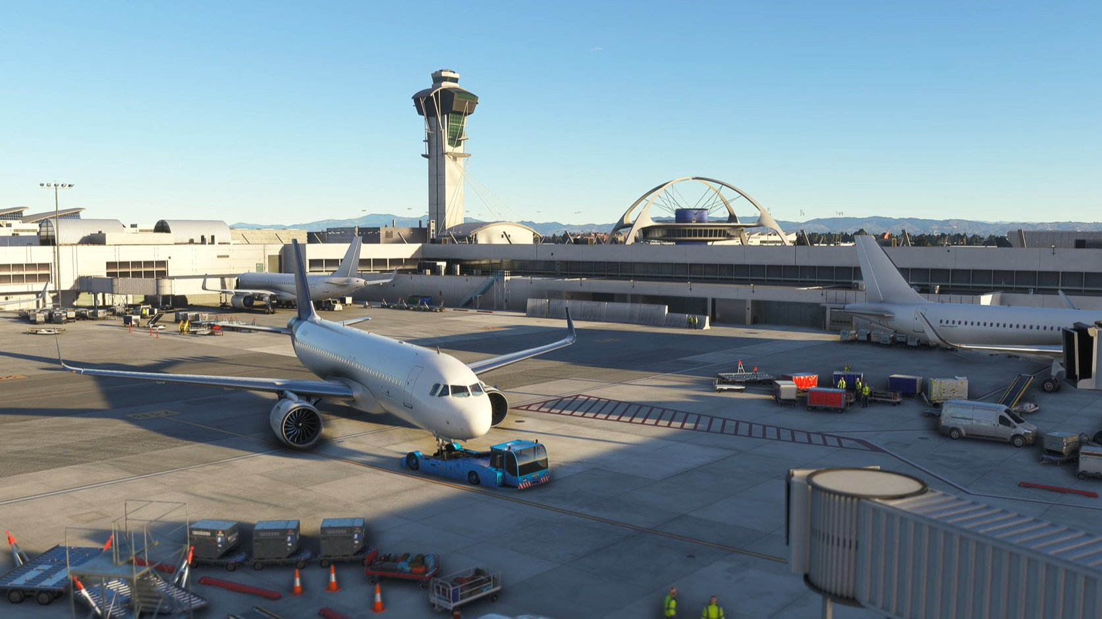
ADVANCED VISUALIZATION FOR A FLIGHT SIMULATOR
DEPARTMENT OF PHYSICS
Group Members
OWOO MARVEL NII KWARTEI
AZAMETSI ISHMAEL KWEKU
AARON TEYE PINTO
GIDISU PRINCE
SUPERVISOR: Dr AKYANA BRITWUM

Slide 2
Outline
Introduction
Theory
Methodology

Slide 3
INTRODUCTION Background
Flight simulators were developed in the late 1920’s and 1930’s with the help of mechanical devices.
The simulation environment at the time did not have any resemblance with the real world.
As technology improved, the demand for more realistic and detailed scenery rose.

Slide 4
Background cont.
Developers began to employ third party software in adding sceneries to the flight simulation.
Many flight schools began to use a flight simulator as part of their flight training.
There was then the need to get these virtual sceneries to mimic the real world environment.

Slide 5
Problem Statement
It has been identified that most sceneries do not have a very close resemblance of the areas they try to depict.
Some simulators do not also have the virtual environment of some domestic airports e.g. Kumasi Airport

Slide 6
Objectives
Main Objective:
The main goal of this project is to model sceneries of the Kumasi airport and some significant areas in Kumasi into the X-plane Flight Simulator.
Specific Objectives:
Marking out and extraction of satellite images of specific areas.
3D modeling of the various structures and objects into the virtual environment.

Slide 7
Specific Objectives Cont.
Examining the geometric optics in relation to the scenery environment built.
Testing and debugging of the 3D models created in the X-plane Flight simulator.
Simulation of the finalized or finished works.

Slide 8
Justification
The virtual sceneries generated into the flight simulator have the ability to generate an immersive experience for the pilot.
It aids in building the situational awareness of the pilot.
It provides cues for the pilots or flight instructors to assist them in altering their altitude, speed, and other controls.
Notes:
It creates an immersive experience in the sense that it imprints on the minds of the pilots the various locations that they are able to find in the flight simulator thus making it more easier for them to identify in the real world.

Slide 9
THEORY
A great number of features in a flight simulator scenery are primarily built from satellite imagery which provide the much information on the terrain.
The building of these scenery imitations are generated using 3D open source suits which allow us to imitate those structures we are replicating.
Geometrical optics helps us to analyze the behavior of light and its interaction with the structures as they are being created.

Slide 10
THEORY Cont.
The law of reflection also serves as an essential principle when enhancing the representation in the virtual scenery.
Waterbodies and other natural features such as highlands are also considered in the modeling.
The X-plane flight simulator also serves as one best flight simulator known to show higher degrees of realism.

Slide 11
Methodology
The work is initiated by marking out the desired section of the map you want to obtain the satellite images of.
Ortho4xp is one essential software that aids in the latitude and longitude selection and sourcing of the images.
In this project the desired satellite imagery chosen was google satellite (GO2) amongst all others.

Slide 12
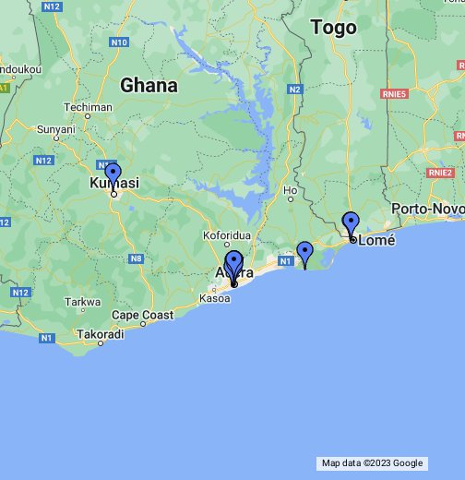
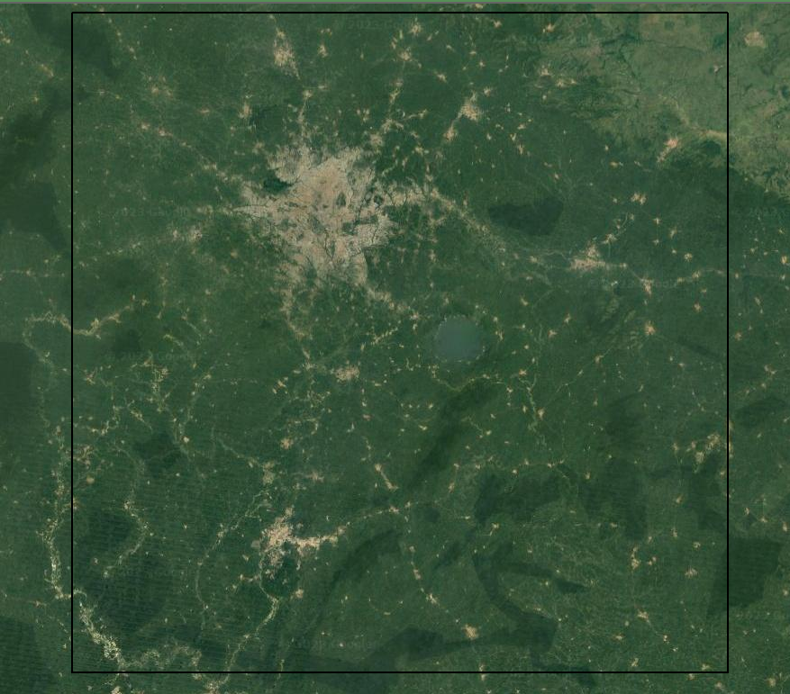
Images of Extraction Process

Slide 13
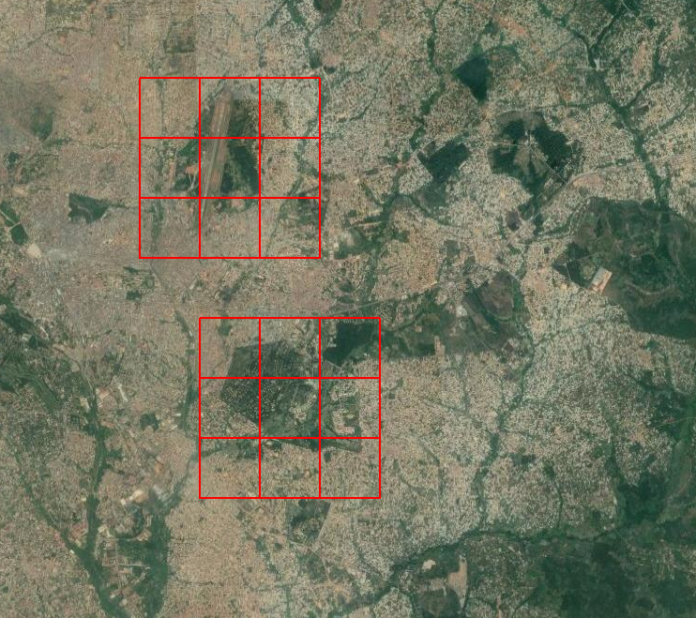
Zoom level Selections

Slide 14
Methodology Cont.
The images are then viewed to verify whether they indeed provide us with features on the exact location chosen.
When the images do not depict the precise areas intended to be worked upon, the marking out and extraction has to be done again.
Once the desire images are obtained they are now exported into a third party software known as World Editor (WED).

Slide 15
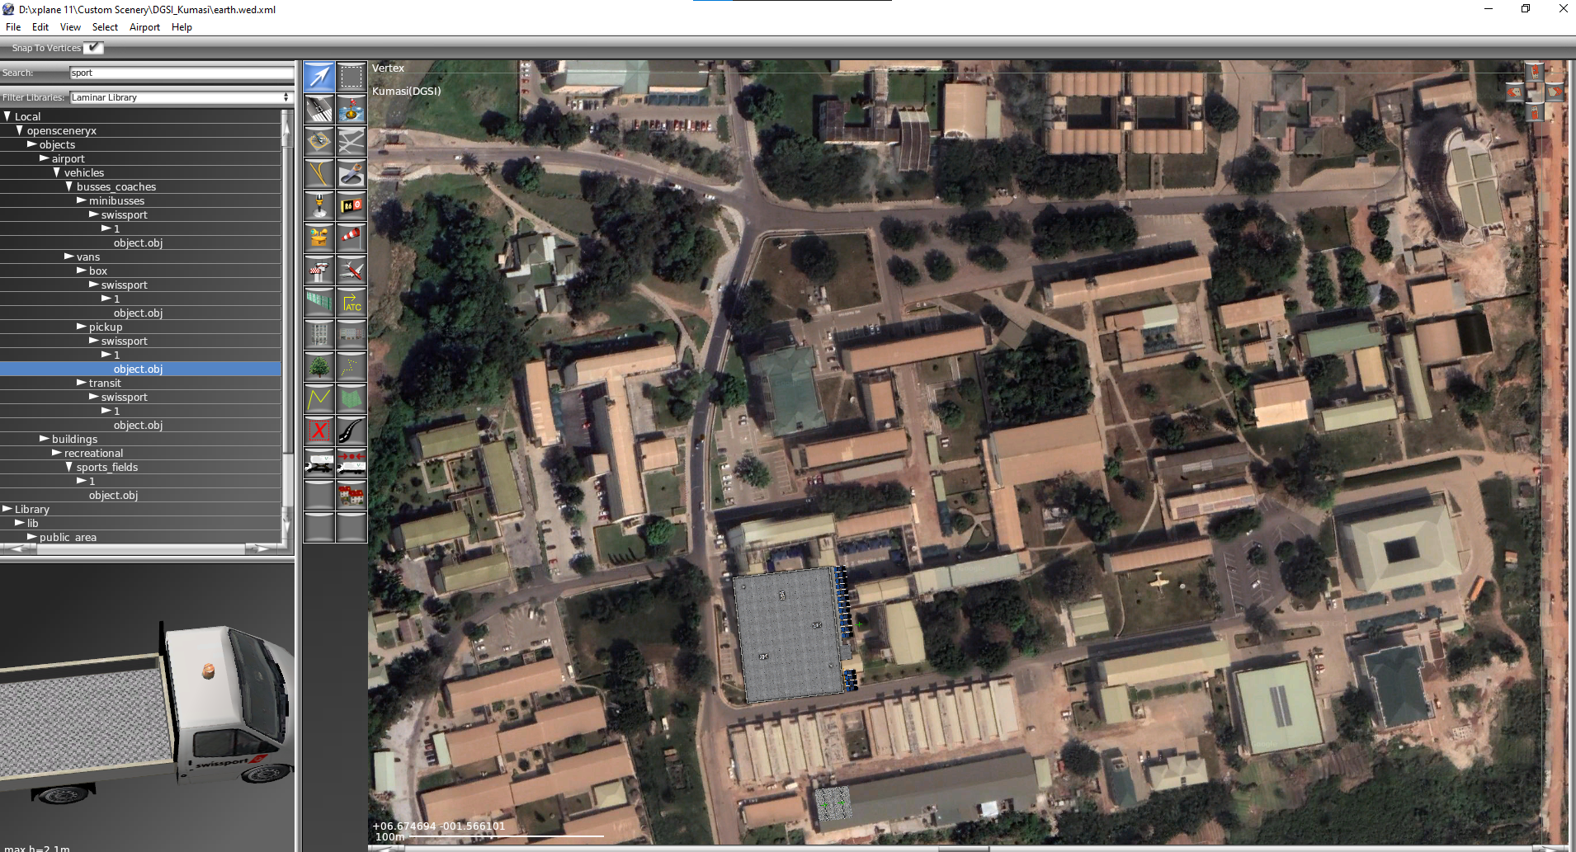
Work Being Carried Out In WED

Slide 16
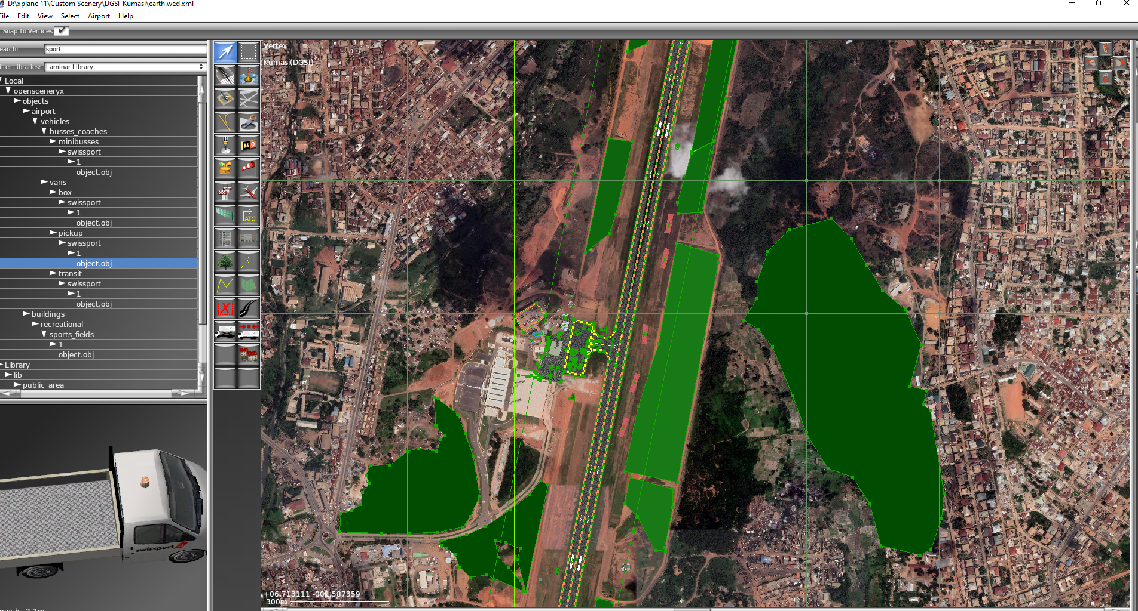
Work done so far on Kumasi Airport Area

Slide 17
Methodology Cont.
Once we have our images showing in our World Editor, we have to then model them into 3D objects.
The blender software helps in making such 3D object creating and testing for simulations, animations, gaming and many others.
The nature of work provided in the blender gives a lot of detail and appreciation to a structure it tries to mimic.

Slide 18
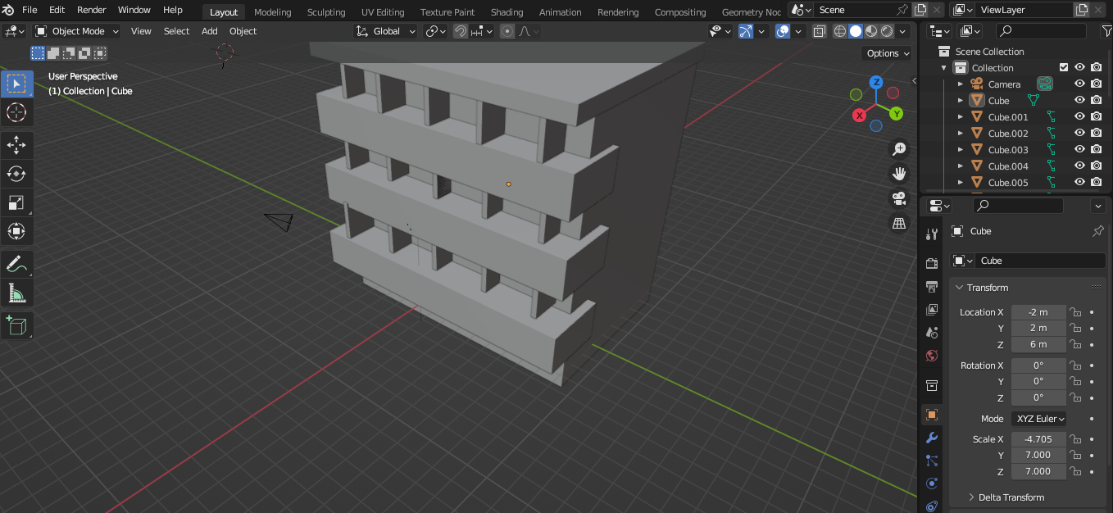
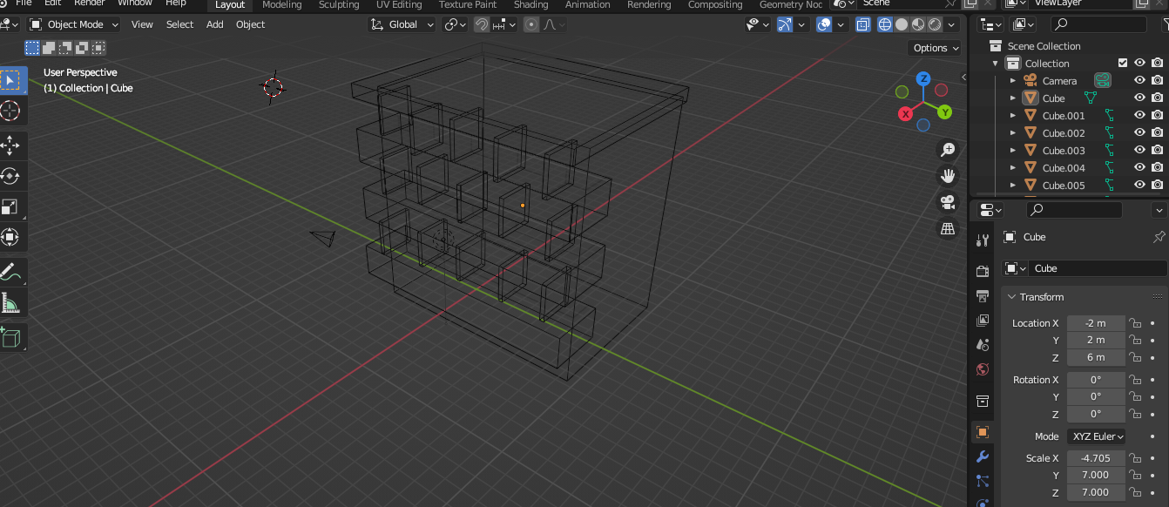
Work being carried out in Blender

Slide 19
THANK YOU

